Slide 1

Project 3 Female and Male Eyes classification Using Deep Learning

Slide 2
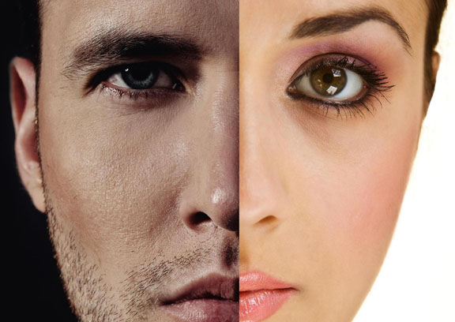

Slide 3
